Slide 1

Parallel Computing in .NET 4 and Visual Studio 2010
James Kolpack, InRAD LLC popcyclical.com

Slide 2

CodeStock is proudly partnered with:
RecruitWise and Staff with Excellence - www.recruitwise.jobs
Send instant feedback on this session via Twitter:
Send a direct message with the room number to @CodeStock
d codestock 406 This session is great!
For more information on sending feedback using Twitter while at CodeStock, please see the “CodeStock README” in your CodeStock guide.

Slide 3


Slide 4
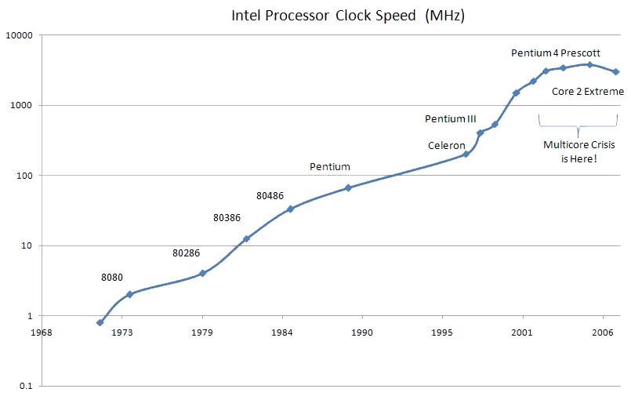
Parallel computing
Manycore machines…
…have arrived!

Slide 5
“Free Lunch” is over - TANSTAAFL
Performance and Scalability

Slide 6
Outline
Parallel Extensions
Imperative Data Parallelization
Imperative Task Parallelization
Declarative Data Parallelization (PLINQ)
Thread-safe Data Structures
Visual Studio 2010 Concurrency Visualizations

Slide 7
Parallel Extensions
Concurrency .NET Library
Lightweight user-mode runtime
Key benefits
Lightweight tasks, efficient scheduling
Programming model improvements
Unified exception models and scheduling
Great for “Delightfully” Parallel Problems
Computation-intensive processes for large data sets

Slide 8
Decomposition
Breaking a problem into discrete parts
Data Decomposition
Iterations (for loops) over data
Simple!
Task Decomposition
Separate operations that can run independently of each other
…Or both!

Slide 9
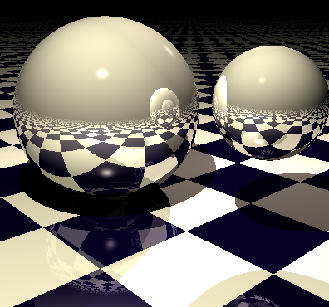
Data Decomposition
int[,] pixelData = new int[rowLen, colLen];
for (int y = 0; y < rowLen; y++)
{
for (int x = 0; x < colLen; x++)
{
pixelData[y, x] = TraceRay(y, x);
}
}

Slide 10
Sequential
x1
x2
x3
x4
y1
y2
y3
y4
codeSample();

Slide 11
Thread for each Row
x1
x2
x3
x4
y1
y2
y3
y4
codeSample();

Slide 12
Threading with 2 Partitions
x1
x2
x3
x4
y1
y2
y3
y4
codeSample();

Slide 13
Imbalanced Workload
x1
x2
x3
x4
y1
y2
y3
y4

Slide 14
Dynamic Partitioning
x1
x2
x3
x4
y1
y2
y3
y4

Slide 15
Partitioning Tradeoffs
More Load-Balancing
Fully Static
Fully Dynamic
Less Synchronization

Slide 16
Partitioning Strategies
Fully Static
Fully Dynamic

Slide 17
Partitioning Strategies
Load Balancing
Dynamic Chunks

Slide 18
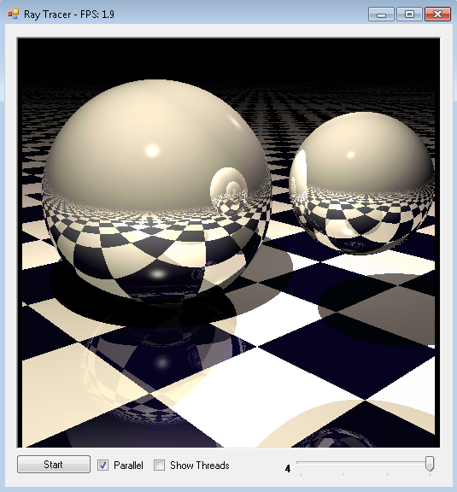
Sample Application
For Real Ray Tracer
Samples for Parallel Programming with .NET 4 code.msdn.microsoft.com/ParExtSamples

Slide 19
Parallel Extensions Architecture
.NET Program
Imperative Parallel Algorithms
Compiler
C#
Task Parallel Library (TPL)
Data Structures
VB
Parallel Constructs
Concurrent Collections
Synchronization Types
Coordination Types
F#
Tasks and Tasks Scheduling
C++
Threads
(any other)
Algorithms
IL
Proc 1
…
Proc p

Slide 20
Lambda Expressions
(input parameters) => expression
bool MyFunc(int i, string s)
{
return s.Length > i;
}
(int i, string s) => s.Length > i
() => SomeMethod()
(input parameters) => {statement;}
(int i, string s) => { Console.WriteLine(
“str: {0} int: {1}”, s, i);
}
void MyAction(int i, string s)
{
Console.WriteLine(
“str: {0} int: {1}”, s, i);
}

Slide 21
Generic Delegates
TResult Func<out TResult>() TResult Func<in T1, out TResult>(in T1)
TResult Func<in T1, in T2, out TResult>(in T1, in T2)
Func<int, string, bool>
Func<int, string, bool> f = (int i, string s) => s.Length > i;
Func<int, string, bool> f = MyFunc;
bool MyFunc(int i, string s) {}
void Action<>() void Action<in T1>(in T1)
Void Action<in T1, in T2>(in T1, in T2)
Action<int, string> a = (int i, string s) => { Console.WriteLine(
“str: {0} int: {1}”, s, i); }
Action<int, string> a = MyAction;
void MyAction(int i, string s) {}

Slide 22
Imperative Data Parallelization
Parallel.For, Parallel.ForEach
Exception handling
Cancelling
Break and Stop
Thread-local state
Nested parallelism
Dynamic thread counts
Efficient load balancing
Parallel.For(0, n, i =>
{
// ...
});
Parallel.ForEach(data, d =>
{
// ...
});
codeSample();

Slide 23
Imperative Task Parallelization
Tasks - Lighter weight than raw Threads
Intelligent scheduling using ThreadPool
Rich API for fine grained control
Waiting, cancellation, continuations, exceptions, etc
Parallel.Invoke(
() => DoComputation(),
() => DoAnotherCompuation()
);
codeSample();

Slide 24
Concurrent Collections
Concurrent Collections
Thread-safe!
Time-outs and waits
Throttling
Cancellation
Classes
BlockingCollection<T>
ConcurrentDictionary<T>
ConcurrentQueue<T>
ConcurrentStack<T>
ConcurrentBag<T>
codeSample();

Slide 25
Parallel Extensions Architecture
.NET Program
PLINQ Execution Engine
Declarative Parallel
Queries
Imperative Parallel Algorithms
Query Analysis
Data Partitioning
Operator Types
Merging
Compiler
C#
PLINQ
Task Parallel Library (TPL)
Data Structures
VB
Parallel Constructs
Concurrent Collections
Synchronization Types
Coordination Types
F#
Tasks and Tasks Scheduling
C++
Threads
(any other)
Algorithms
IL
Proc 1
…
Proc p

Slide 26
Parallel LINQ (PLINQ)
Declarative Data Parallelization
Describe what we want rather than how to accomplish it
For LINQ to Object queries
System.Linq.Parallel
.AsParallel()
codeSample();

Slide 27
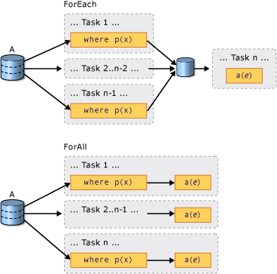
PLINQ ForAll
codeSample();

Slide 28
PLINQ Performance Considerations
Computational cost of the overall work
The form of query execution
With ToArray or ToList, all results must be merged
The type of merge options
Buffered or Streaming
The kind of partitioning
Sequential mode fall-back
var queryA = from num in numberList.AsParallel() select ExpensiveFunction(num); //good for PLINQ var queryB = from num in numberList.AsParallel() where num % 2 > 0 select num; //not so good for PLINQ

Slide 29
Parallel API Review
Imperative Data Parallelization
System.Threading.Tasks.Parallel
Imperative Task Parallelization
System.Threading.Tasks
Declarative Data Parallelization (PLINQ)
System.Linq.Parallel
Thread-safe Data Structures
System.Collections.Concurrent
Parallel.For(0, n, i => {});
Parallel.ForEach(data, i => {});
var t = Task<TResult>
.Factory
.StartNew(() => {});
t.Wait();
from n in nums.AsParallel()
select ExpressiveFunction(n);
new BlockingCollection<string>();

Slide 30

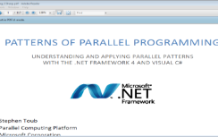
Parallel Patterns
Fork/Join
Recursive Decomposition
Aggregations
Dependencies
Producer/Consumer
MapReduce
Fold and Scan
Shared State
Anti-Patterns

Slide 31
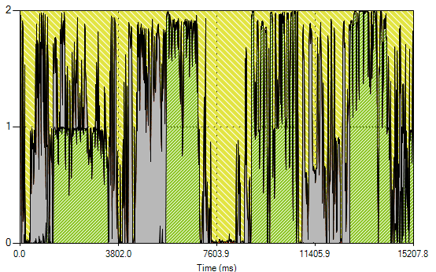
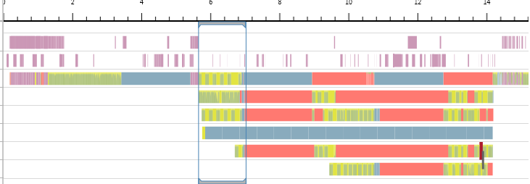
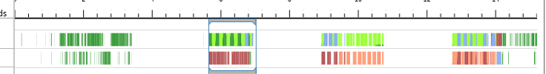
Concurrency Visualizers
CPU Utilization View
Threads View
Cores View

Slide 32
Links
MSDN Parallel Programming in the .NET Framework bit.ly/bo73EI
Patterns for Parallel Programming – Stephen Toub bit.ly/caxi9I
MSDN Parallel Computing Portal msdn.com/concurrency
Blog series on Parallelism in .NET by Reed Copsey Jr. reedcopsey.com/category/algorithms/parallelism

