Slide 1

Introduction to
Windows PowerShell
James Kolpack, InRAD LLC
popcyclical.com
Come up and pick up a PowerShell Quick Reference handout
Adapted from a Keith Hill Presentation

Slide 2

CodeStock is proudly partnered with:
RecruitWise and Staff with Excellence - www.recruitwise.jobs
Send instant feedback on this session via Twitter:
Send a direct message with the room number to @CodeStock
d codestock 413c This session is great!
For more information on sending feedback using Twitter while at CodeStock, please see the “CodeStock README” in your CodeStock guide.

Slide 3
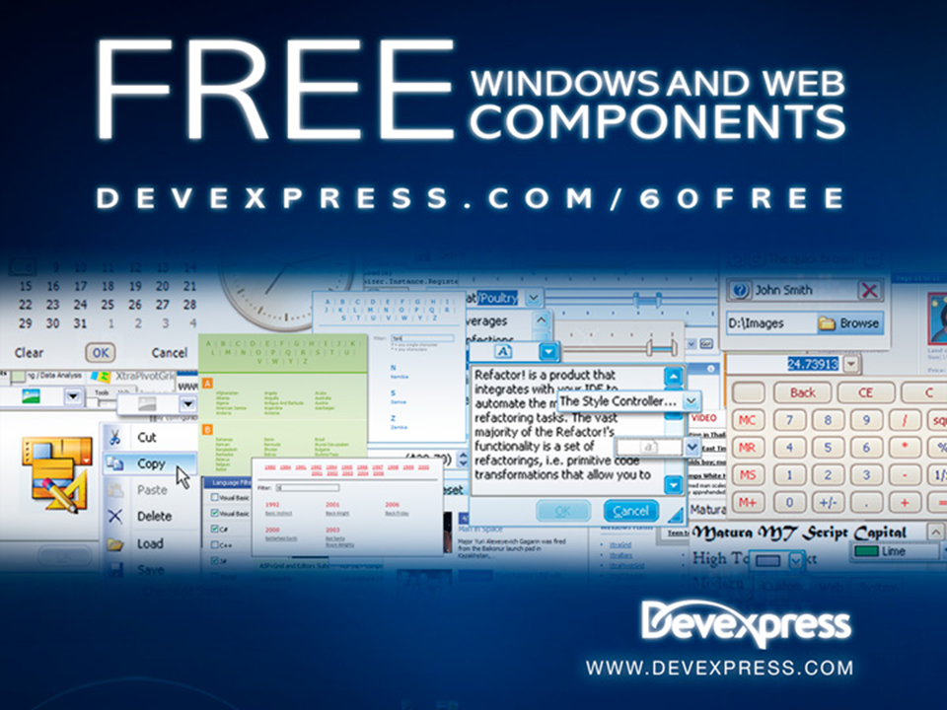

Slide 4

What is Windows PowerShell
Dynamic scripting language
Next generation command-line shell for Windows

Slide 5
What can it do?
Automate complex, repetitive tasks
.NET Interactive Prompt
Build command line utilities
Host-able script engine
Windows Server management
  Exchange 2007+
  SQL Server 2008+
  IIS 7.0+

Slide 6
PowerShell Innovations
Cmdlets
Providers
.NET type system
Object flow pipeline
Intrinsic support for regular expressions, WMI and XML
Extensible

Slide 7
Getting Started…
Download and Install
  http://support.microsoft.com/kb/968929
Set PowerShell to allow script execution.
  PS> Set-ExecutionPolicy Unrestricted
Check out the community extensions for dozens of new commands you might find useful
  http://pscx.codeplex.com/

Slide 8
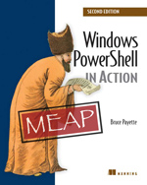
Resources
Title | What? | Where? http://...
Microsoft Scripting Center | An actively updated resource from Microsoft. Includes introductory material, articles, webcasts, script repository, and more. | technet.microsoft.com/ scriptcenter/ powershell.aspx
Windows PowerShell In Action | Author Bruce Payette, one of the principal creators of PowerShell, gives this comprehensive tome on everything about the language and how to apply it. Become an expert! | manning.com/ payette
Intro to Windows PowerShell | A reference library of PowerShell examples ranging everywhere between “Getting Started” to advanced topics. | www.computerperformance.co.uk/powershell
Keith Hill | PowerShell MVP and Community Extensions coordinator – wrote the demo script | keithhill.spaces.live.com
Power-Scripting Podcast | Podcast on Windows PowerShell with Jonathan Walz and Hal Rottenberg | powerscripting.net

Slide 9
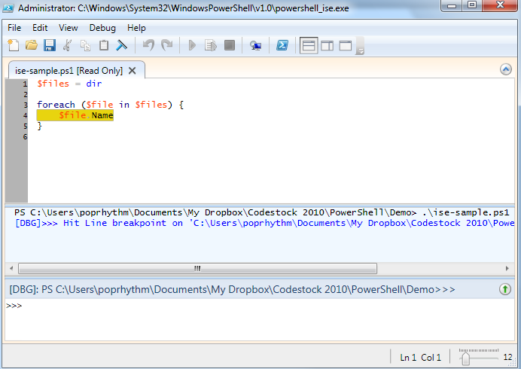
Integrated Scripting Environment

Slide 10
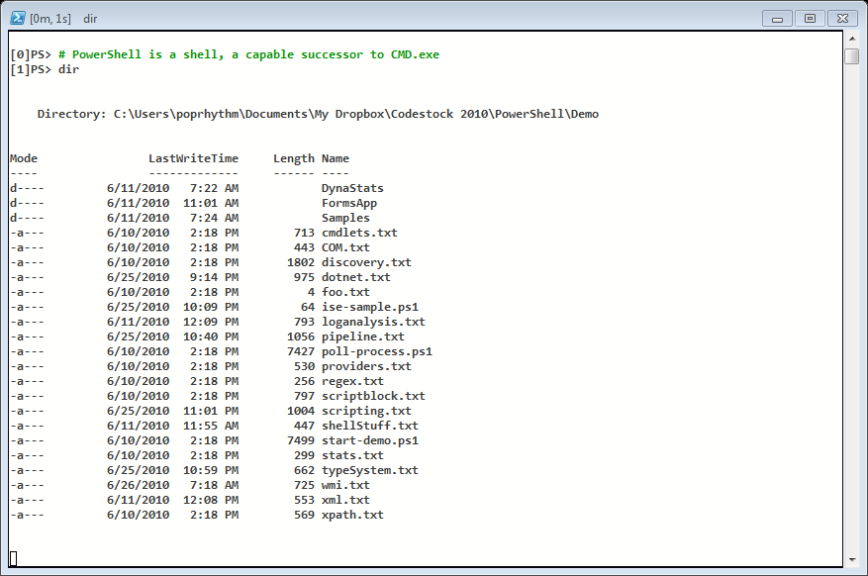
DEMO SCRIPT

Slide 11
Shell Stuff
Jump start with familiar commands
  cd
  dir
  type
  copy
  del
PS>.\shellStuff.ps1

Slide 12
Cmdlets
Composable cmdlets
  “Simple” cmdlets strung together via pipeline and/or script to perform “complex” tasks.
Standardized naming scheme for cmdlets
  <verb>-<noun> Get-Date, Remove-Item
Extensible by 3rd parties (PowerShell Community Extensions)
PS>.\cmdlets.ps1

Slide 13
The Pipeline
Cmdlets output .NET objects (structured information) instead of unstructured text.
“Compose” cmdlets together using the pipe “|” character
ObjectFlow engine manages objects in the pipeline:
  “unrolls” collections, outputting each individual element
  Coerces objects for parameter binding
  Renders to a textual view for interactive users and legacy apps (stdout)
Extended Type System
  Wrapper types around objects are created to stash book-keeping info
  PSObject, PSCustomObject, GroupInfo, MatchInfo
Legacy apps dump text (System.String objects) into the pipeline
PS>.\pipeline.ps1

Slide 14
Pipeline Cmdlets
Manipulators of generic objects!
  Blades of the PowerShell Swiss Army Knife
Where-Object
  Filters incoming object stream.
  get-process | where { $_.HandleCount –gt 500 }
Sort-Object
  Sorts the stream of objects based on one or more properties or an expression.
  get-childitem | sort LastWriteTime -desc
Select-Object
  Projects properties and expands collections into custom object.
  get-process | select ProcessName –Exp Modules
Group-Object
  Transforms stream of objects into a stream of GroupInfo objects that share a common property.
  get-childitem | group Extension

Slide 15
Pipeline Cmdlets Continued
Foreach-Object
  Manipulate individual objects in stream.
  $feed.rss.channel.item | foreach { $_.Title }
Measure-Object
  Calculates stats such as sum, min, max, ave, lines, characters, words

Slide 16

PowerShell Pipeline: Moving Objects
gps | where { $_.PM –gt 40MB } | sort ProcessName
Process.GetProcesses()
System.Diagnostics.Process
System.Diagnostics.Process
where
Process.PagedMemorySize > 40*1024*1024
System.Diagnostics.Process
No
Yes
System.Diagnostics.Process
System.Diagnostics.Process
Sort on Process.ProcessName
System.Diagnostics.Process
System.Diagnostics.Process
System.Diagnostics.Process
Handles NPM …
------- --- ---
105 111
89 99
System.Diagnostics.Process
out-default
System.String
System.String

Slide 17
Type System: Formatting Output
Format-Table (ft)
  Displays output in tabular format
  Limited number of properties can be displayed in tabular form
  PowerShell sizes columns evenly use -autoSize for better sizing
Format-List (fl)
  Displays properties in a verbose list format
  A view may be defined to limit output in list mode - use fl * to force display of all properties
Format-Wide (fw)
  Displays a single property in multiple columns
  Use -autoSize parameter for better column sizing
PS>.\typeSystem.ps1

Slide 18
Providers
Prompt doesn’t always reside in the file system
PowerShell ships with providers for:
  File system, registry, environment, variables, functions, aliases and the certificate store
Manipulate various stores as-if a file system
Extensible by 3rd parties (PowerShell Community Extensions)
PS>.\providers.ps1

Slide 19
Scripting Language: Variables
Variables are always prefixed with $ except:
  gps -OutVariable Procs –ErrorVariable Err
  Set-Variable FirstName 'John'
Can be loosely or strongly typed:
  $a = 5
  $a = "hi"
  [int]$b = 5
  $b = "hi" # Errors since $b is type int
  $c = [int]"7" # Coerce string to int
Automatic variables
  $null, $true, $false, $error, $?, $LastExitCode, $OFS, $MyInvocation

Slide 20
Scripting Language - Variables
Global variables: $home, $host, $PSHome, $pid, $profile, $pwd
Scoped variables:
  Qualified variable names: $global:foo; $script:bar; $local:baz; $private:ryan
  Normal scope resolution on reads when not using qualified name
  Copy on write semantics for child scopes unless using qualified name
  Private scoping prevents child scopes from seeing variable

Slide 21
Scripting Language: Data Types
All .NET types with special support for:
  Array: $arr = 1,2,3,4
  Hashtable: $ht = @{key1="foo"; key2="bar"}
  Regex: $re = [regex]"\d{3}-\d{4}"
  Xml: $xml = [xml]"<a><b>text</b></a>“
Numerics support:
  $i = 10; $d = 3.14; $d2 = 3e2; $h = 0x20
  Support for K, M and G numeric suffixes e.g.:
  1KB = 2¹⁰, 1MB = 2²⁰, 1GB = 2³⁰

Slide 22
Scripting Language: Strings
$str = "Hello World"
The escape character is ` (backtick)
`` `' `" `$ `0 `a `b `f `n `r `t `v
Variable evaluation in strings
  Double quotes interpolate and single quotes don’t:
  "Pi is $d" => Pi is 3.14
  'Pi is $d' => Pi is $d
Here strings – literal multi-line
$str = @"
>> Here strings can have embedded new lines
>> and they provide the closest thing to a block comment in v1.0.
>> "@
>>

Slide 23
Scripting Language: Operators
Type of Operation | Operators
Arithmetic: Numeric | + - * / () %
Arithmetic: String | + to concatenate, * to repeat "-" * 72, -f formatting
Assignment | = += -= *= /= %= ++ --
Negation | ! -not
Comparison: General | -eq -lt -gt -le -ge -ne -and -or
Comparison: String | -ceq -clt -cgt -cle -cge -cne -like –notlike -match -notmatch -clike -cnotlike -cmatch -cnotmatch
String Manipulation | -replace
Array | -contains -ccontains
Bitwise | -band -bor -bnot
Type test/conversion | -is -isnot -as
“c” indicates case sensitive
Remember: Many operators start with hyphens

Slide 24
Scripting Language: Control Flow
Conditionals:
  if ($a –gt 0) {
  "positive"
  }
  elseif ($a –eq 0) {
  "zero"
  }
  else {
  "negative"
  }
  switch ($op) {
  "add" { $op1 + $op2 }
  "sub" { $op2 - $op1 }
  default { "unrecognized operator: $op" }
  }

Slide 25
Scripting Language: Control Flow continued
Loops:
  while ($i –lt 10) {
  ($i++)
  }
  for ($i = 0; $i –lt 10; $i++) {
  $i
  }
  foreach ($arg in $args) {
  $arg
  }

Slide 26
Scripting Language: Functions
Simple function defined at command prompt:
  PS> function Greeting($name) { "Hello $name" }
Flexible function parameters
  Loose or strong typing
  Named parameters
  Optional parameters
  Extra parameters available via $args
  function addNumbers([int]$x, [int]$y = 0) {
  $total = $x + $y
  foreach ($arg in $args) {
  $total += [int]$arg
  }
  $total
  }

Slide 27
Scripting Language – Error Handling
Errors come in terminating and non-terminating flavors
  Terminating errors are usually generated by script (null ref exception)
  Non-terminating errors are usually generated by cmdlets (access denied)
Trap terminating errors using trap statement
  trap [exception] { <block to execute> (break|continue) }
Trap non-terminating errors using -ErrorAction parameter
  get-process | select –expand Modules –ea SilentlyContinue
  ErrorAction parameters: Stop, Inquire, Continue, SilentlyContinue

Slide 28
Scripting Language: Misc
Array Manipulation
  $arr = 1,2,3,4
  $arr += 5,6,7,8
  $arr[2..4] => 3 4 5
  $arr[0..3+5..7] => 1 2 3 4 6 7 8
Command Substitution
  echo "The time is $(get-date)"
Comment character
  # comments to end of line
Dot source script file to import into current scope
  PS C:\> . .\vs80vars.ps1
PS>.\scripting.ps1

Slide 29
Working with .NET Objects
Create new objects
  $webClient = new-object System.Net.WebClient
Get and set properties
  (get-date).Year
  (get-item foo.txt).IsReadOnly = $true
Call methods
  "Hello World".split(" ")
Access static members
  [Math]::Pow(2,30) # PowerShell prepends 'System.'
  [DateTime]::UtcNow # if type name not found
PS>.\dotnet.ps1; .\regex.ps1; .\xml.ps1

Slide 30
WMI and PowerShell
(Windows Management Instrumentation)
Get-WMIObject
  Get-Help -name Get-WMIObject
  get-wmiobject -namespace "root\cimv2" –list
Access filesystem information
  $disks = gwmi Win32_LogicalDisk –computername localhost
  $disks[0].freespace
  $disks[0].freespace/1gb
  $disks[0].filesystem
Get a list of the Hotfixes that have been installed
  $hotfixes = gwmi Win32_QuickFixEngineering –computername localhost
  $hotfixes | format-table Hotfixid
OperatingSystem
  gwmi win32_OperatingSystem -computername localhost
PS>.\wmi.ps1
Notes:
The CIMV2 namespace groups a set of classes and instances that relate to aspects of the local Windows environment.

Slide 31
Storing Script Blocks as Data
Script can be stored as data and later executed, like a lambda expression
PS> $script = {get-process}
PS> $script
get-process
PS> &$script
Handles NPM(K) PM(K) WS(K) VS(M) CPU(s) Id ProcessName
------- ------ ----- ----- ----- ------ -- -----------
102 5 1088 3332 32 0.17 2092 alg
614 43 16760 25236 88 62.16 2740 CCAPP
283 5 3860 3536 43 2.44 388 CCEVTMGR
PS>.\scriptBlock.ps1

Slide 32
PowerShell 2.0 – new stuff
Remote management and invokes
Integrated Scripted Environment
Eventing
Background jobs
Modules (new way to extend PowerShell)
Misc enhancements, perf improvements and bug fixes

Slide 33
Resources
Come up and pick up a PowerShell Quick Reference handout
Title | What? | Where? http://...
Microsoft Scripting Center | An actively updated resource from Microsoft. Includes introductory material, articles, webcasts, script repository, and more. | technet.microsoft.com/ scriptcenter/ powershell.aspx
Windows PowerShell In Action | Author Bruce Payette, one of the principal creators of PowerShell, gives this comprehensive tome on everything about the language and how to apply it. Become an expert! | manning.com/ payette
Intro to Windows PowerShell | A reference library of PowerShell examples ranging everywhere between “Getting Started” to advanced topics. | www.computerperformance.co.uk/powershell
Keith Hill | PowerShell MVP and Community Extensions coordinator – wrote the demo script | keithhill.spaces.live.com
Power-Scripting Podcast | Podcast on Windows PowerShell with Jonathan Walz and Hal Rottenberg | powerscripting.net

Slide 34
Cmdlets compared to Unix Utilities
Characteristics of Unix utilties:
  Specialized and work with unstructured information
  $ find . -type f -name "e*" -exec rm {} ;
Characteristics of PS cmdlets:
  Generic, simple and work with structured information
  PS> dir . -recurse | where {!$_.PSIsContainer -and
  ($_.Name -like "e*")} | remove-item

