Slide 1
Vehicle Mileage Logging and Reporting

Slide 2
Mileage Traker
Vehicle Mileage Logging and Reporting
General usage walkthrough from a driver’s perspective
  Log entry and editing
  Batch import
Administrative functionality
  Reporting and exporting
  Vehicle details
  Vehicle service reminders and service logging
  Importing Fuel Log data
  Vehicle Cost Report

Slide 3
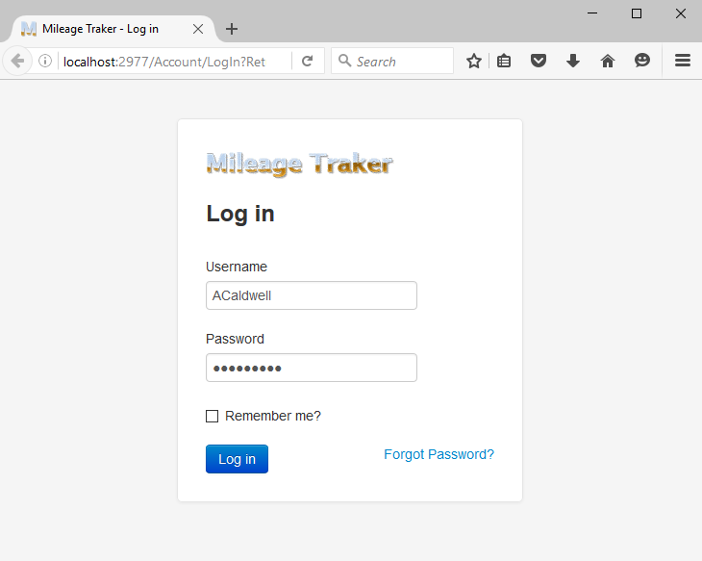

Slide 4
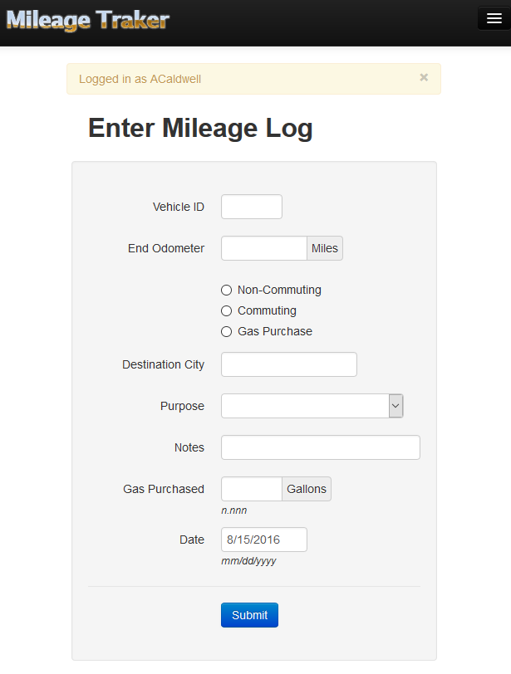

Slide 5
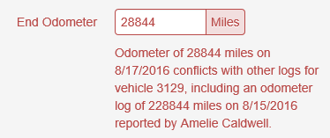
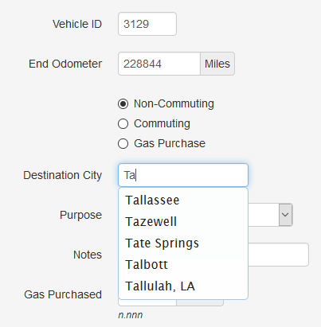
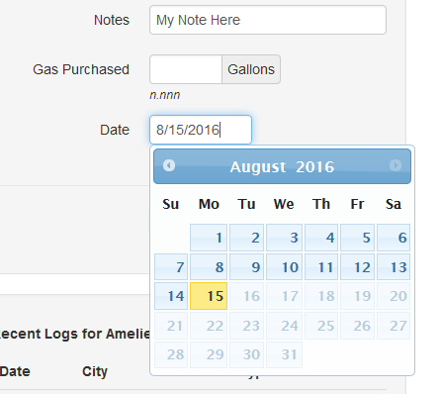
Form Entry Tools and Validation

Slide 6
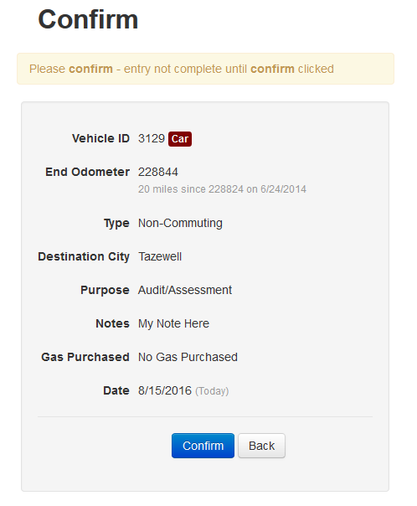

Slide 7

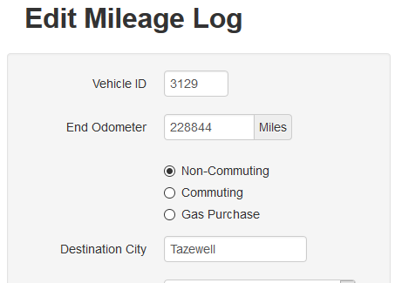

Slide 8
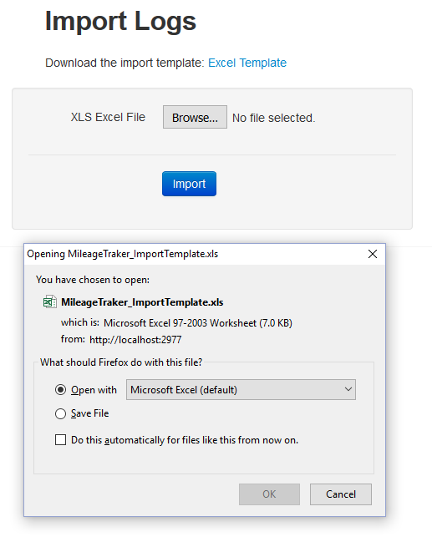
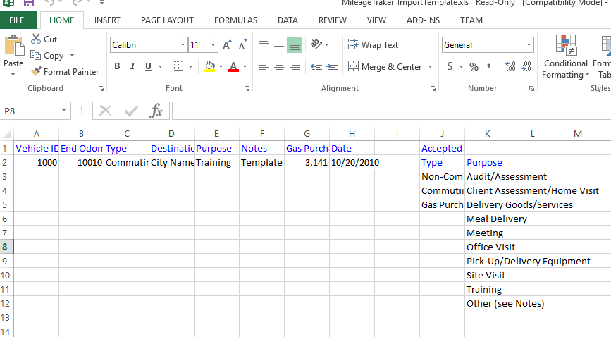

Slide 9
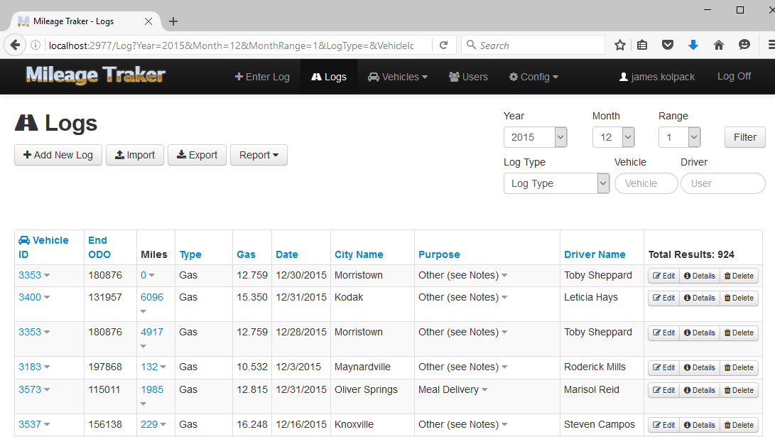

Slide 10
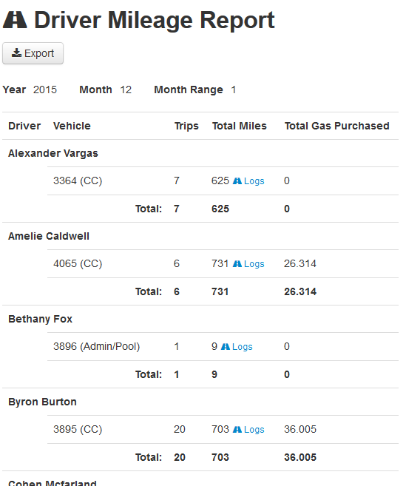
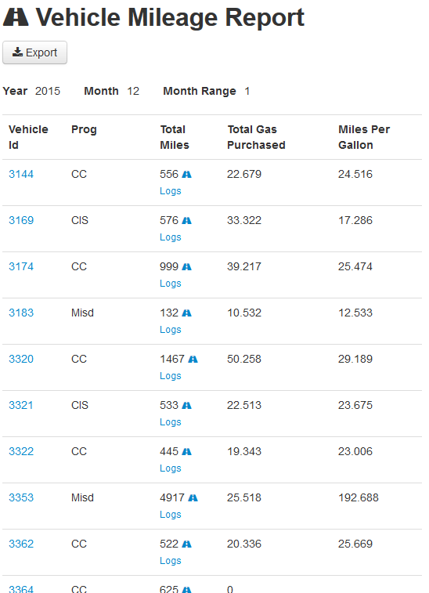

Slide 11
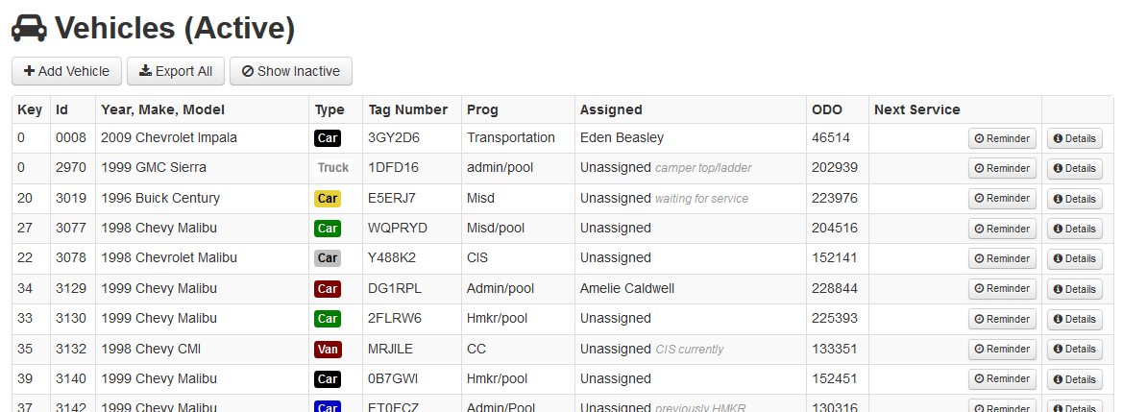

Slide 12
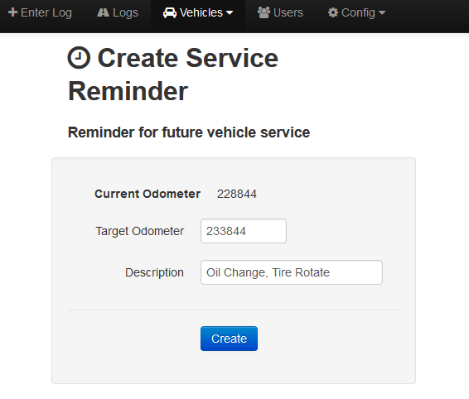

Slide 13



Slide 15


Slide 16
Vehicle Mileage Logging and Reporting

